Slide 1
4883 Programming Techniques Presentation
Created by Jarette Greene

Slide 2
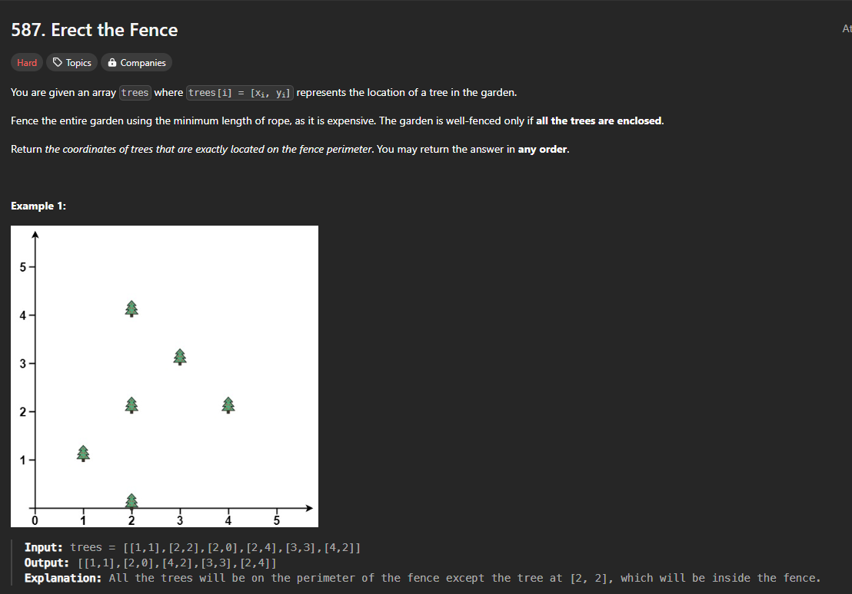
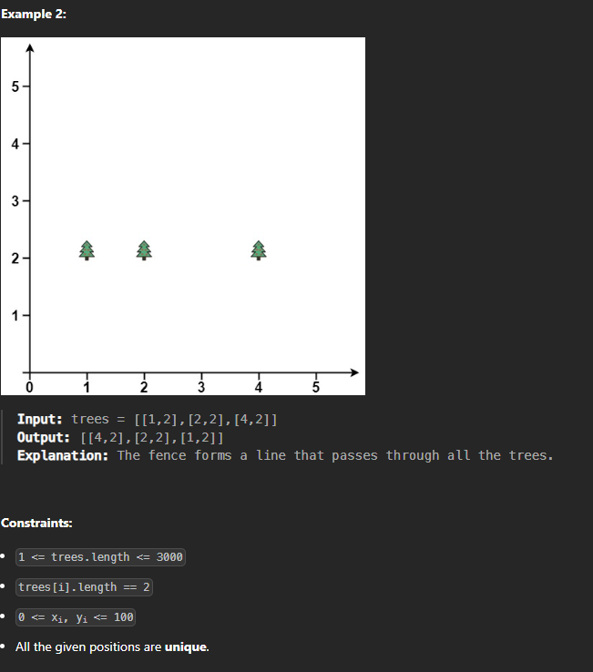
Leet Code 587: Erect Fence

Slide 3
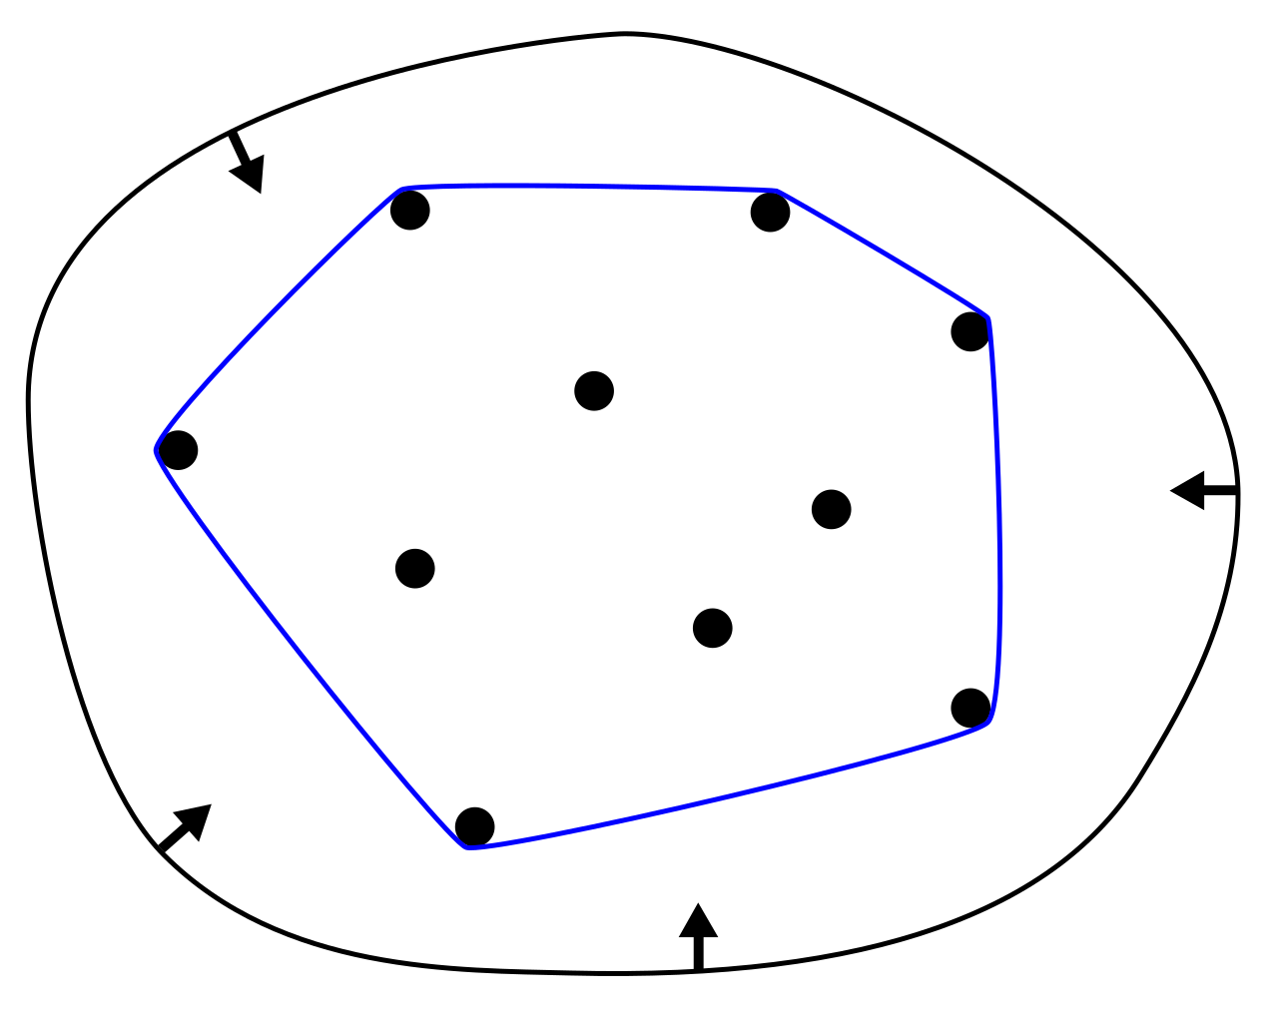
Convex Hull
Definition:
the smallest convex polygon that contains a given set of points.
Algorithms I used to find convex hull:
Graham Scan
Jarvis March (gift wrapping)

Slide 4
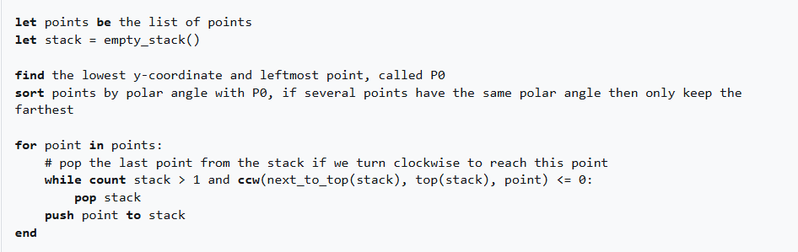
Graham Scan Algorithm
Type: Greedy Algorithm
Time Complexity: O(nlogn)
Pseudocode:

Slide 5
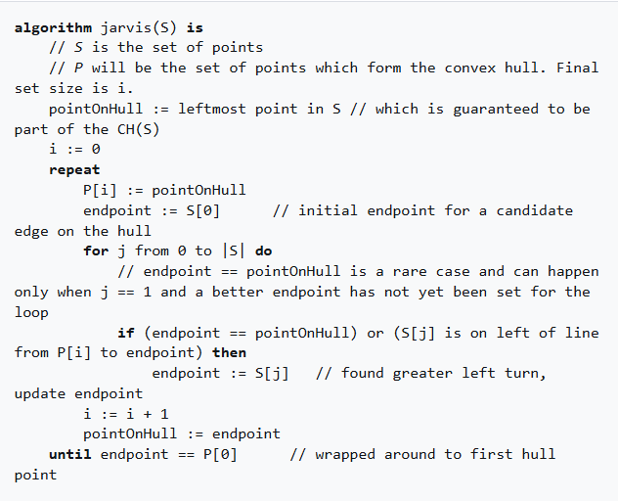
Jarvis March Algorithm
Type: Greedy Algorithm
Time Complexity: O(nh)
Pseudocode:

Slide 6
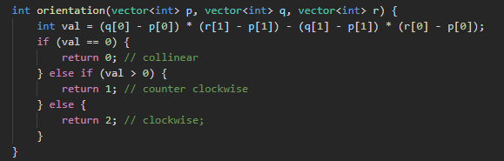
THE MATH!!
The Cross Product:
Used to tell the direction:
C
C
Counter clockwise
BC
Collinear
BC
B
BC
AB
Clockwise
C
A
AB
BC
=
*
AC

Slide 7

THE MATH!!
The Polar Angle:
Distance
This is the angle difference between the surface of one point and another
The physical distance between two points

Slide 8
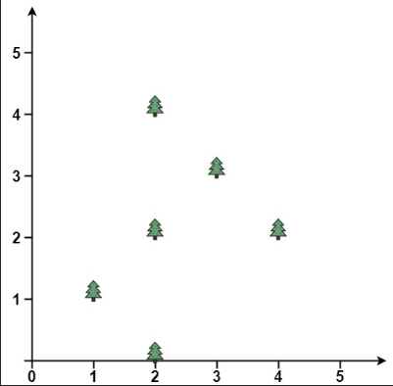
Graham Scan walk through
Steps
Step 1: Find the lowest point (lowest y value)
Clockwise turn
x5
Step 2: Sort based on polar angle from previously found lowest point
Counter clockwise turn found
x3
Step 3: Insert the first two sorted points into the hull stack
x4
x2
Step 4: for 3rd point until the end of points:
While the stack size is > 1 and the orientation between (top of stack - 1), (top of stack), (current point) is clockwise remove the top of stack.
x6
𝛳
x1
Step 5: push point to hull stack
Step 6: repeat step 4 - 5 until end of list.

Slide 9
My Graham Scan Implementation

Slide 10
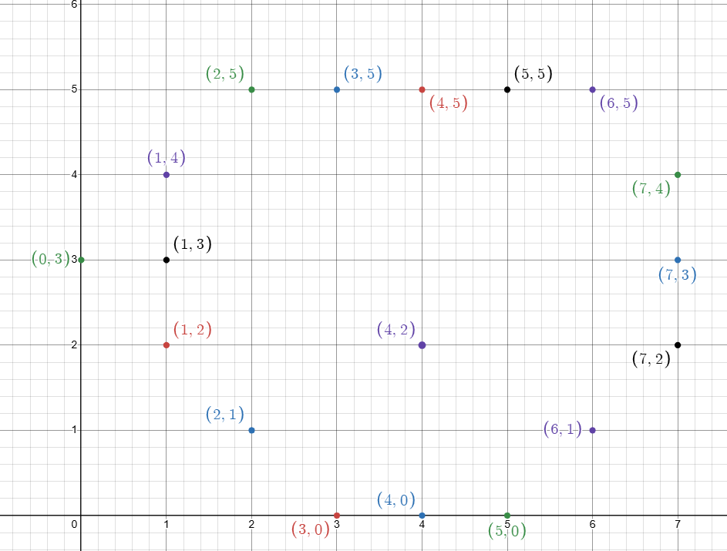
All Points

Slide 11
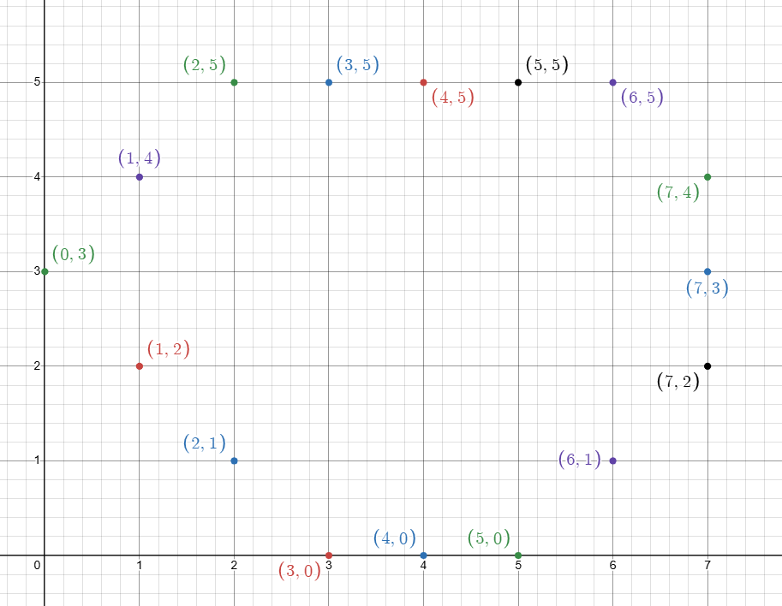
Expected Points

Slide 12
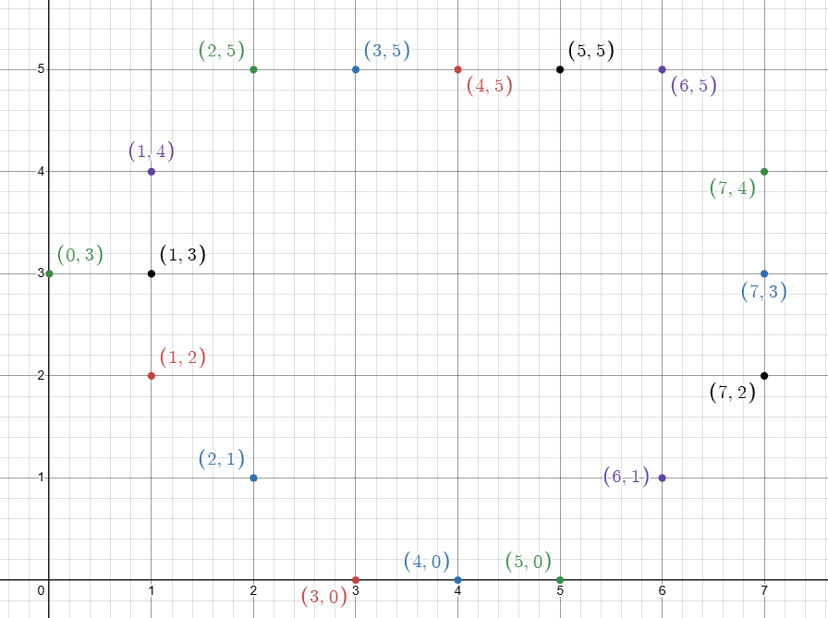
My current solution

Slide 13
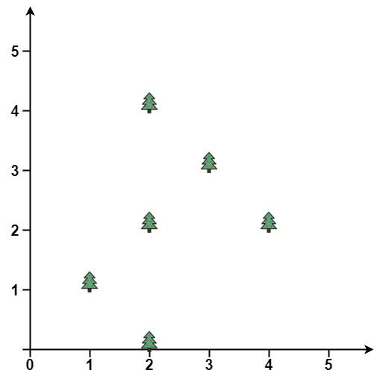
Jarvis March walk through
Steps
Step 1: find leftmost point (smallest x value). Optional sort the points based on x values.
x4
Step 2: Add leftmost to hull then pick next point/ random point as next potential candidate to be added
Step 3: loop through the current points finding the orientation using previous, candidate and current point.
x5
Step 4: if collinear point linear point is found and the distance is greater then update current candidate to the current point if less then add current point to a list of collinear points. If a clockwise turn was made update candidate to current point.
x3
x6
x1
Step 5: after looking at all points push candidate unto the list and update candidate as new previous.
x2
Step 6: Repeat steps 3-5 until the candidate being pushed is same as the start point.

Slide 14
My Jarvis March Implementation

Slide 15
All Points

Slide 16
Expected Points

Slide 17
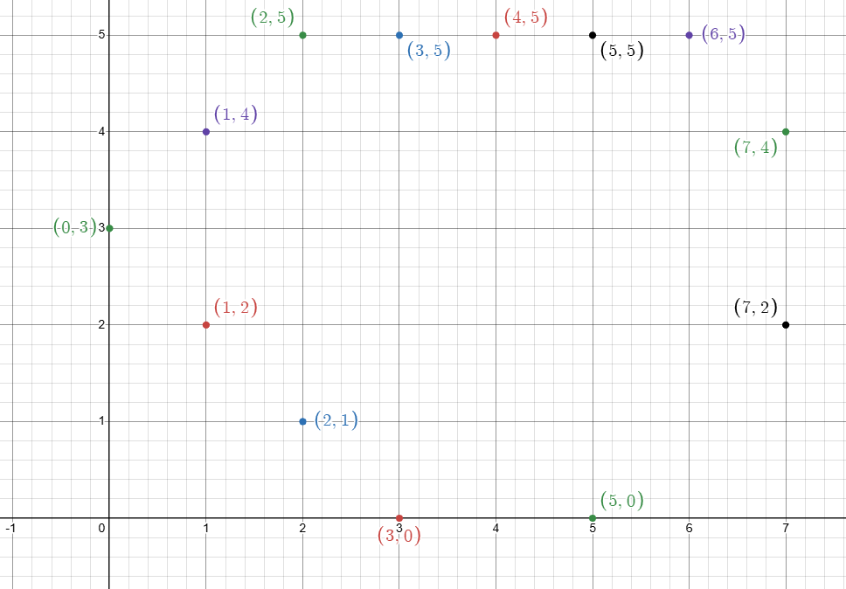
My current solution

